Slide 1
How to create a STORYBIRD
Designed by Yaidy Viviana Cortés
La Estancia San Isidro Labrador

Slide 2
Follow the steps to create a Storybird
Go to: www.storybird.com.
Create an account.
Remember your username and password.

Slide 3
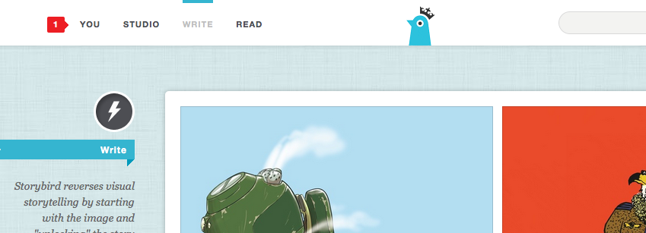
1. Click on: WRITE.

Slide 4
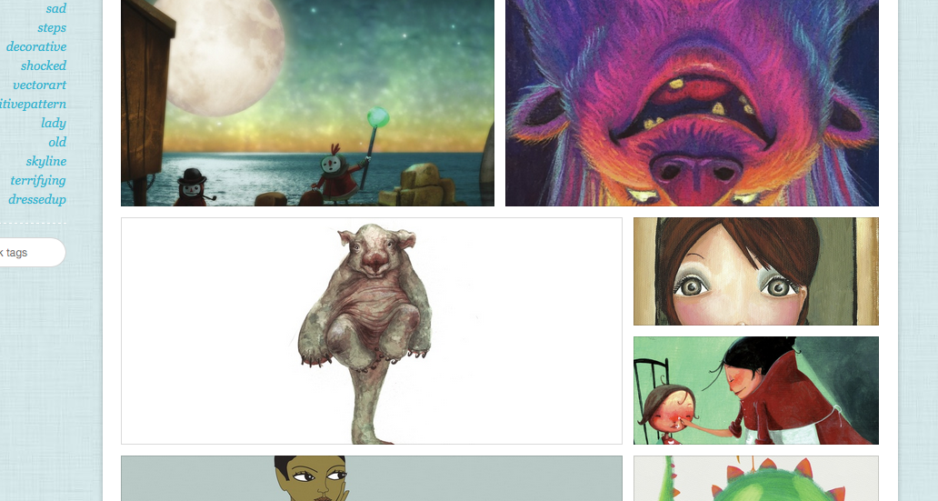
2. There are many images, you can choose the art that you like the most.

Slide 5
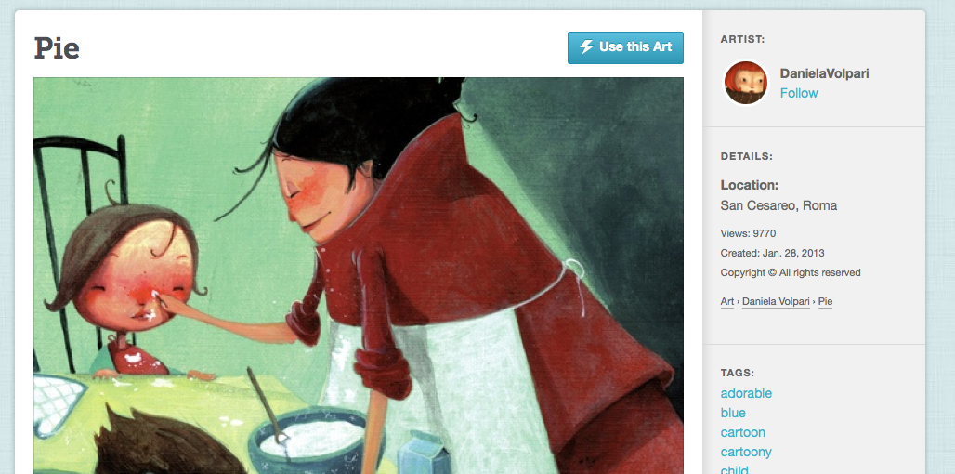
3. After choosing the one that you like, click on USE THIS ART.

Slide 6
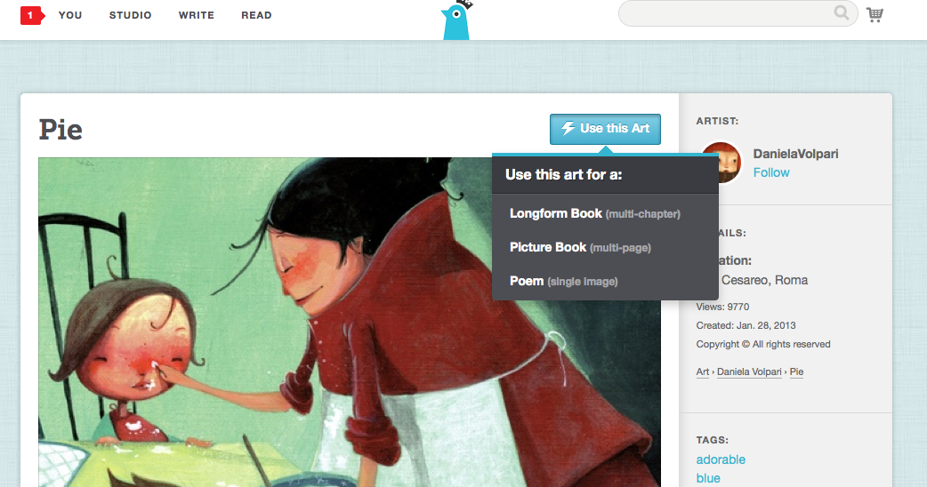
4. Choose the option: PICTURE BOOK (multi-page).

Slide 7
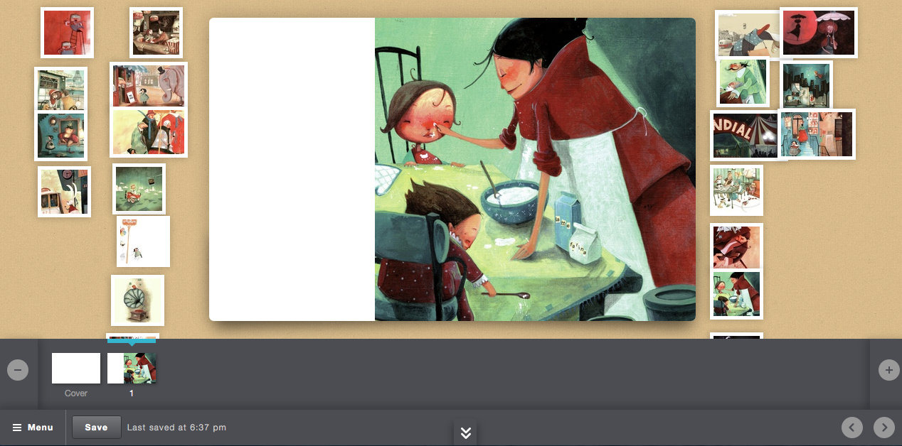
5. Click here to choose the cover of your story.
Save as much as possible.
6. Click here to add more pages.

Slide 8
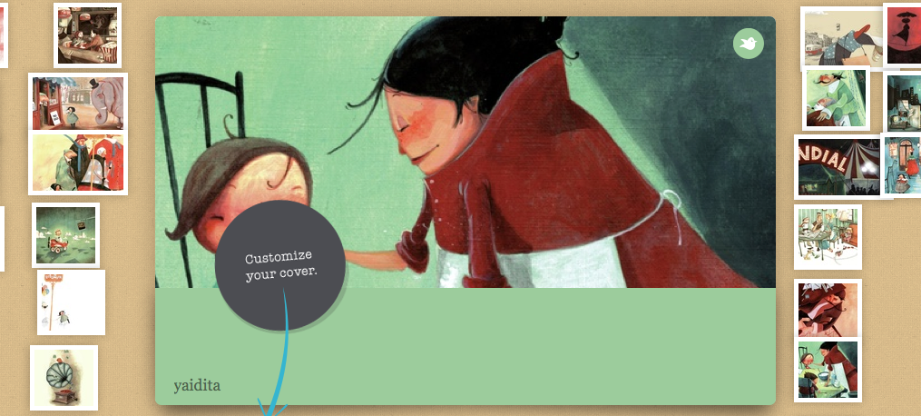
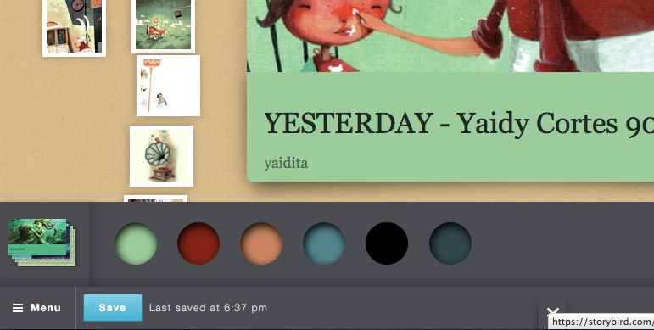
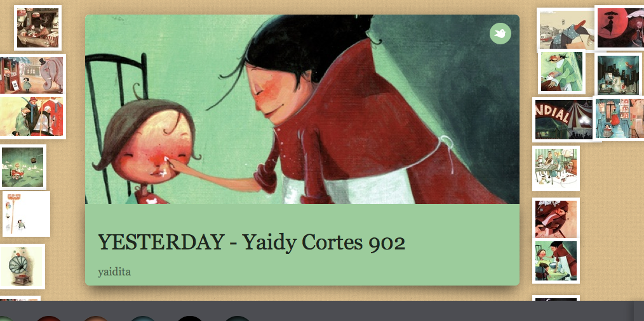
7. Choose the cover you want. They appear below.
8. Write the name of your story, your complete name and your course.
9. Choose the color of your cover.

Slide 9
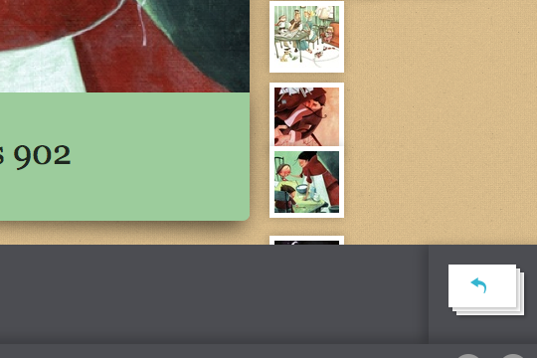
10. To continue with the creation of your story, click here.

Slide 10
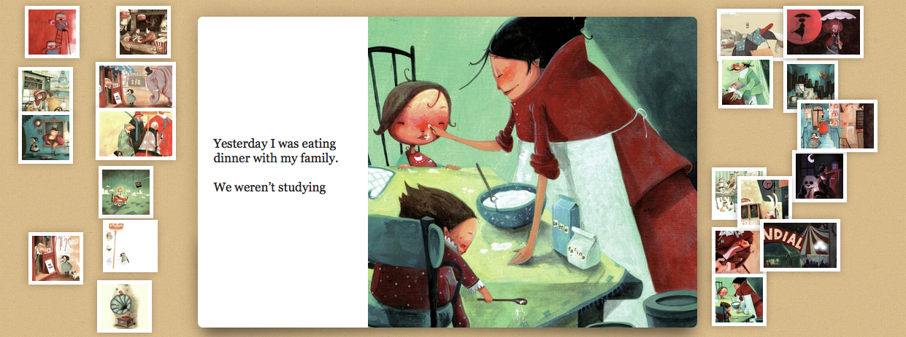
11. There are several images to choose to create your story. Start as you want.
12. Start writing your story using the grammar tense you have learnt.

Slide 11
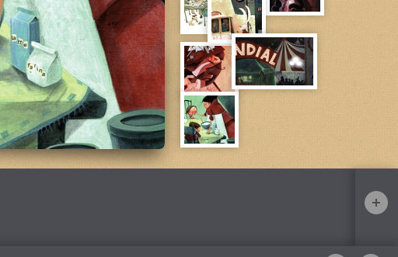
13. Add more slides by clicking here.

Slide 12
14. Create 10 slides.
15. You can see all your slides at the bottom.

Slide 13
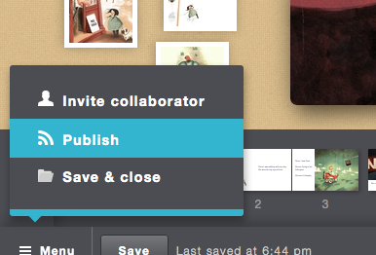
17. Then click on PUBLISH.
16. To Publish, click on Menu.

Slide 14
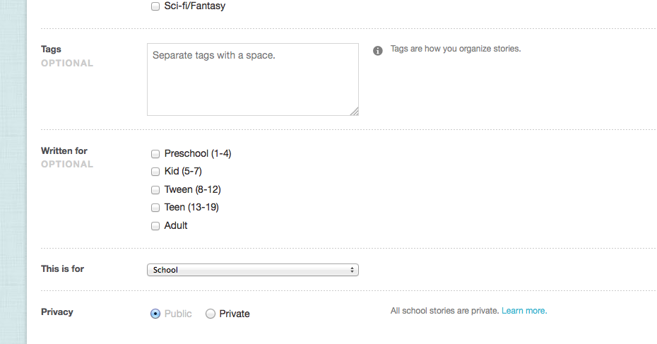
18. Choose PUBLIC.

Slide 15
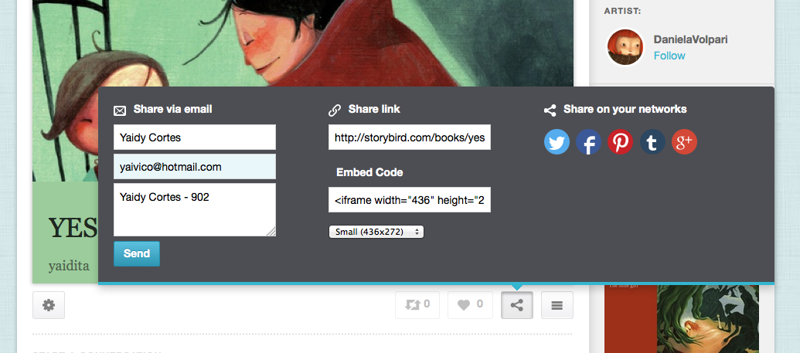
22. Copy the link in your notebook.
23. Share your story bird on Facebook.
19. Write your name.
21. Write your name again.
24. Send.
20. Write the mail of your teacher: yaivico@hotmail.com.

